Slide 1

BC2410, Prescriptive Analytics From Data to Decisions
Lecture 6

Slide 2
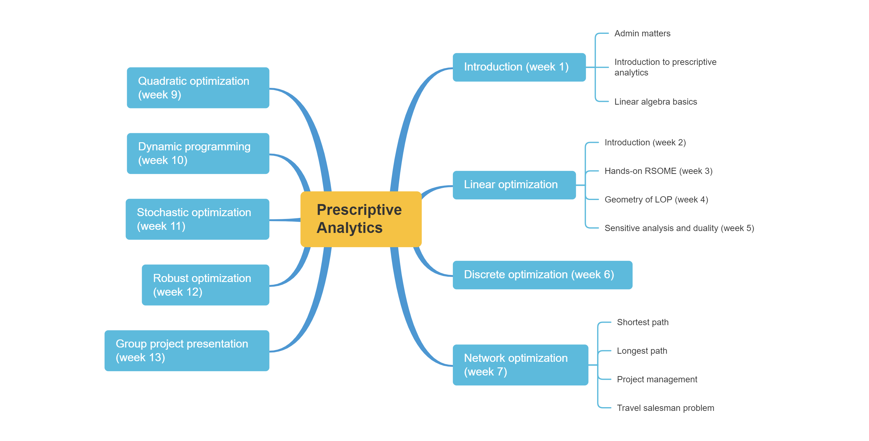
Schedule

Slide 3
Schedule

Slide 4
Discrete Optimization
Discrete optimization is a generalization in which some or all the decision variables must take integer values.
Examples:
Number of people, items, etc
YES/NO decisions (binary)

Slide 5
Types of Discrete Optimization
Integer optimization: all the decision variables are integers and all the constraints and the objective functions are linear.
Binary optimization: all the decision variables are binary and all of the constraints and the objective are linear
Mixed-integer optimization: only some of the decision variables are integer or binary, and all the constraints and the objective function are linear.

Slide 6
Power of Binary Variables
One of the most powerful modeling framework for modeling Yes/No typed decisions.
Usually 1 denotes YES and 0 denotes NO.
Focus on:
Project Selection
Common relations
Fixed cost problems
Case study: Course selection
Sudoku (Optional)

Slide 7
Project Selection Problem
Stockco has $14,000,000 available for investment and is considering five projects. Find the solution which maximizes the total return subject to the budget constraint
Project
Return
$ million
Unit Price
$ million
1
2
3
4
5
6
9
5
4
7
5
7
4
3
4

Slide 8
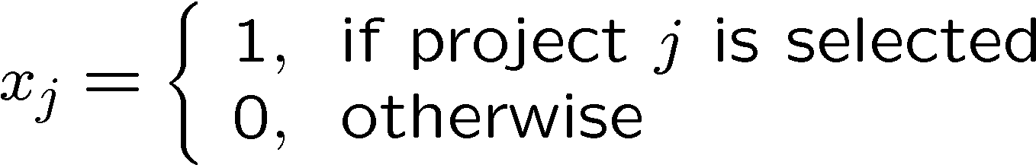
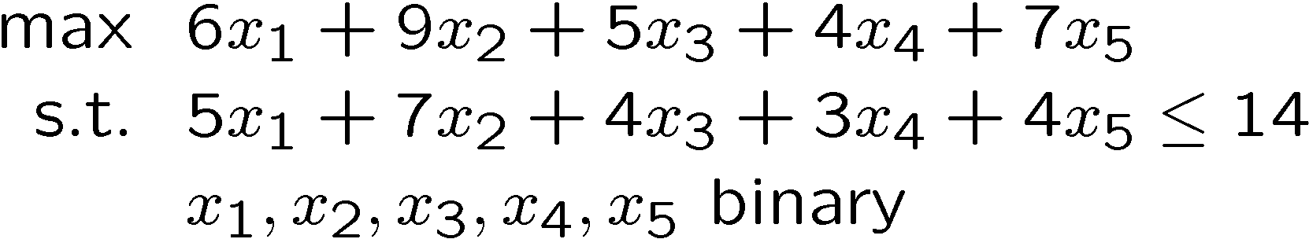
Project Selection Problem
Project
Return
$ million
Unit Price
$ million
1
2
3
4
5
6
9
5
4
7
5
7
4
3
4

Slide 9
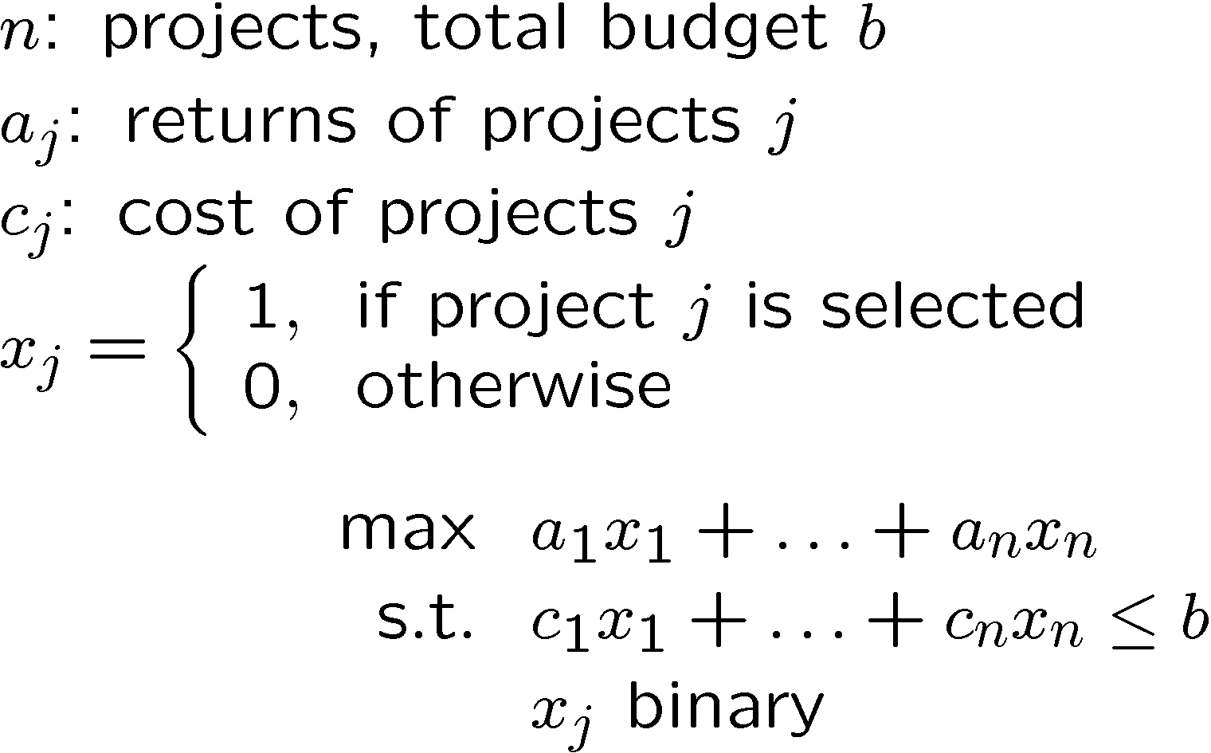
Project Selection Problem
A typical projection problem (or Knapsack Problem)

Slide 10

Project Selection Problem
Project
Decision Variable
Optimal Value
1
2
3
4
5
6
9
5
4
7
0
1
0
1
1

Slide 11
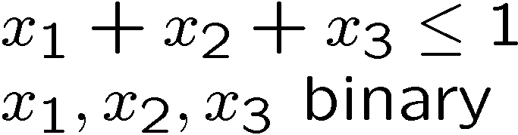
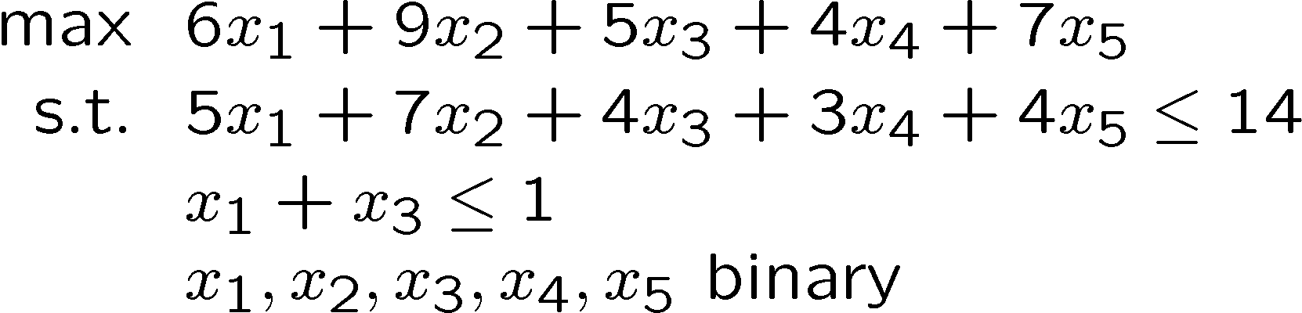
Common Relations
At most one event can occur
Example: Suppose we can only choose project 1 or project 3 but not both.

Slide 12
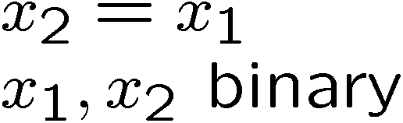
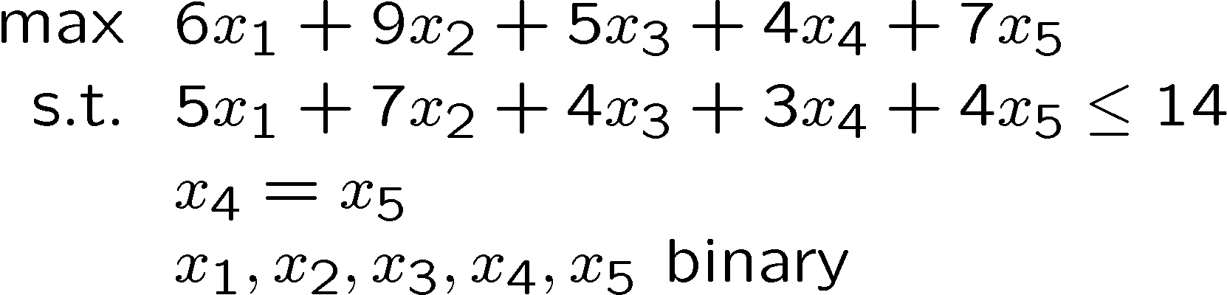
Common Relations
Neither event occurs or both events occur.
Example: Project 4 and 5 must be invested together or left out together.

Slide 13
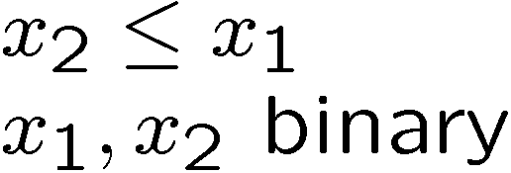
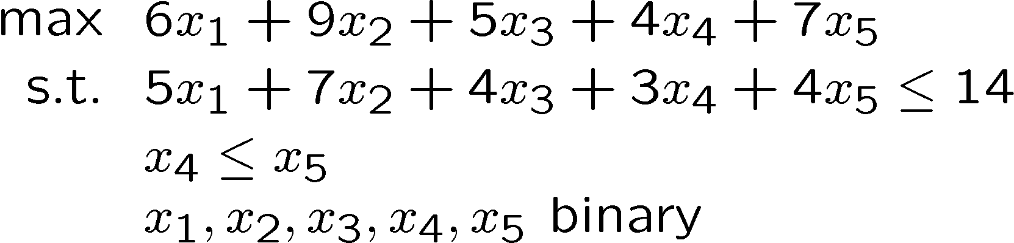
Common Relations
If event 2 occurs, then event 1 must occur. Note that event 1 can occur without event 2.
Example: If Project 4 is chosen, then Project 5 must also be chosen.

Slide 14
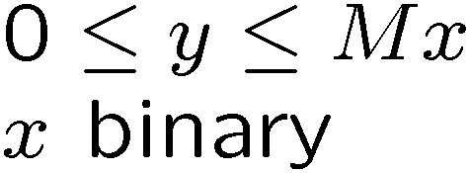
Common Relations
Limit range of variable, y. If event does not occur, then y=0. Otherwise, 0 ≤ y ≤ M if event occurs.
M is a large number that variable y can never attain
Usage Examples:
Stopping production flow if one decides to close down a production plant.

Slide 15
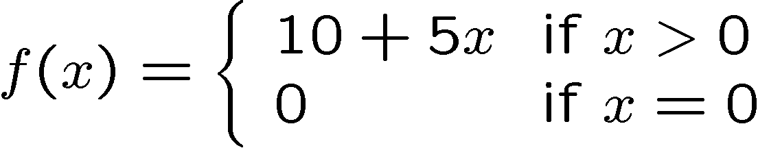
Fixed cost problem
Cost of producing a product follows the following function

Slide 16
Fixed cost problem
A company is considering making 3 different products. Let x₁, x₂, x₃ denote the quantity of each product to be produced.
Product Fixed Cost Unit Profit
1 $ 100 if x₁ > 0 $ 5
$ 0 if x₁ = 0
2 $ 150 if x₂ > 0 $ 7
$ 0 if x₂ = 0
3 $ 75 if x₃ > 0 $ 4
$ 0 if x₃ = 0

Slide 17
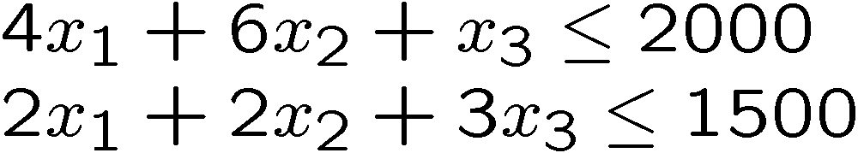
Fixed cost problem
The production constraints are :
Formulate a model for determining the maximum profit production policy.

Slide 18
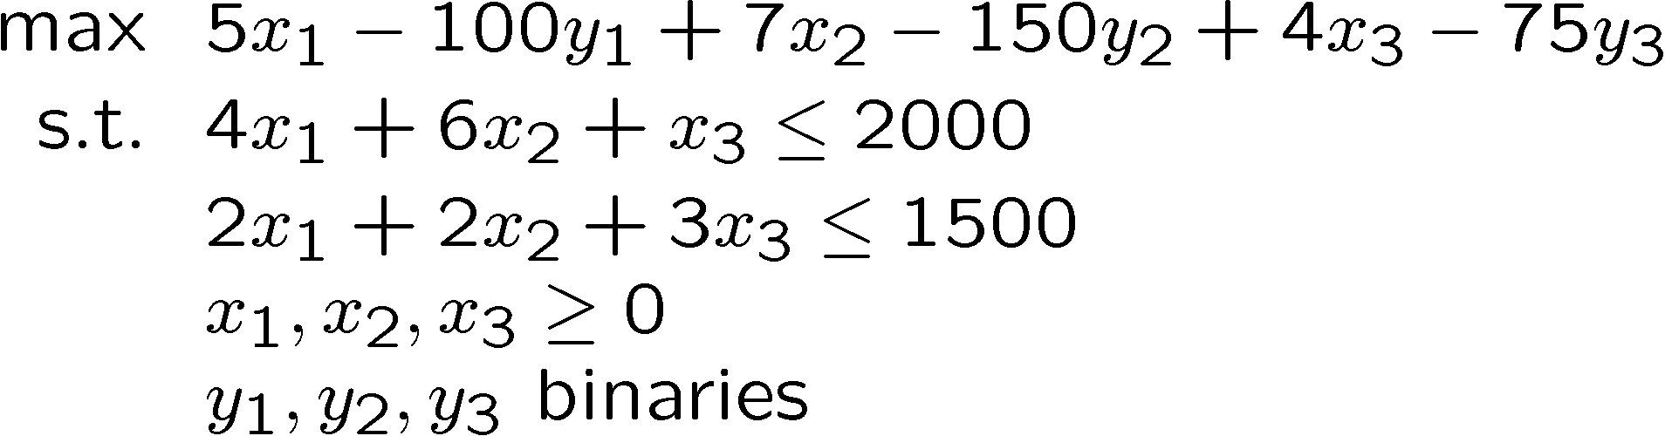
Fixed cost problem
Is this ok?
Notes:
y1 = y2 = y3 = 0

Slide 19
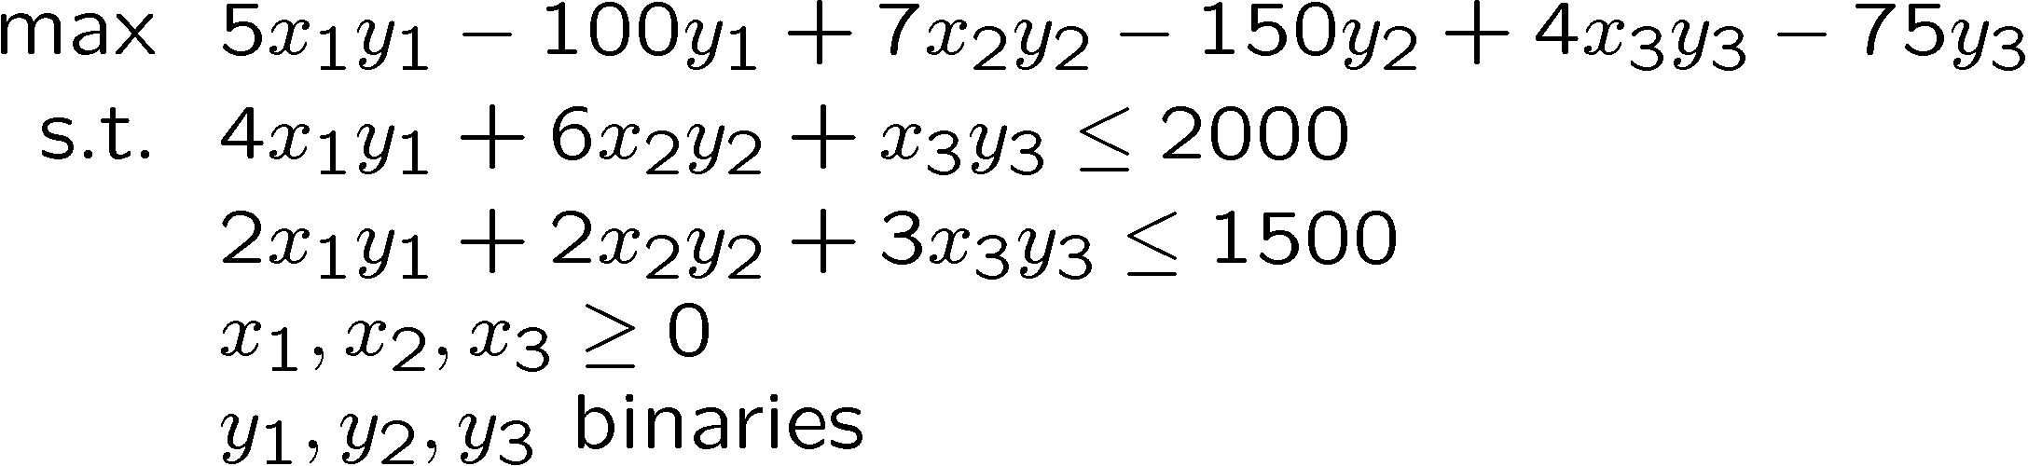
Fixed cost problem
How about this?

Slide 20
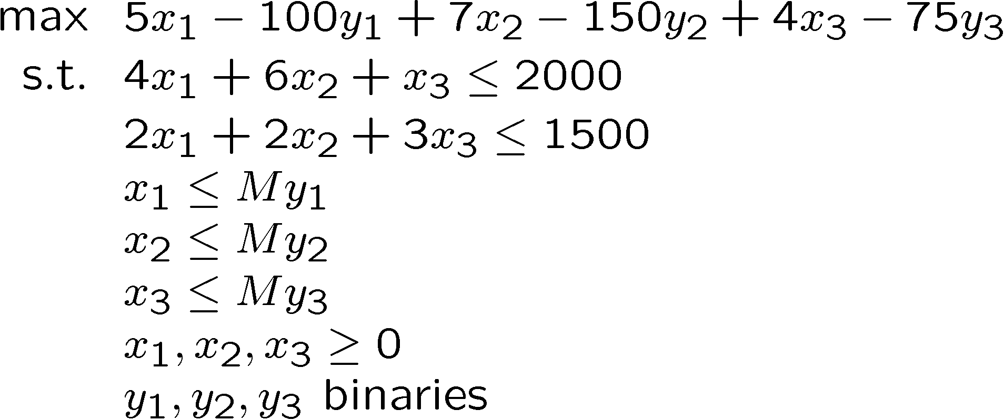
Fixed cost problem
How about this?
How should we choose M?

Slide 21
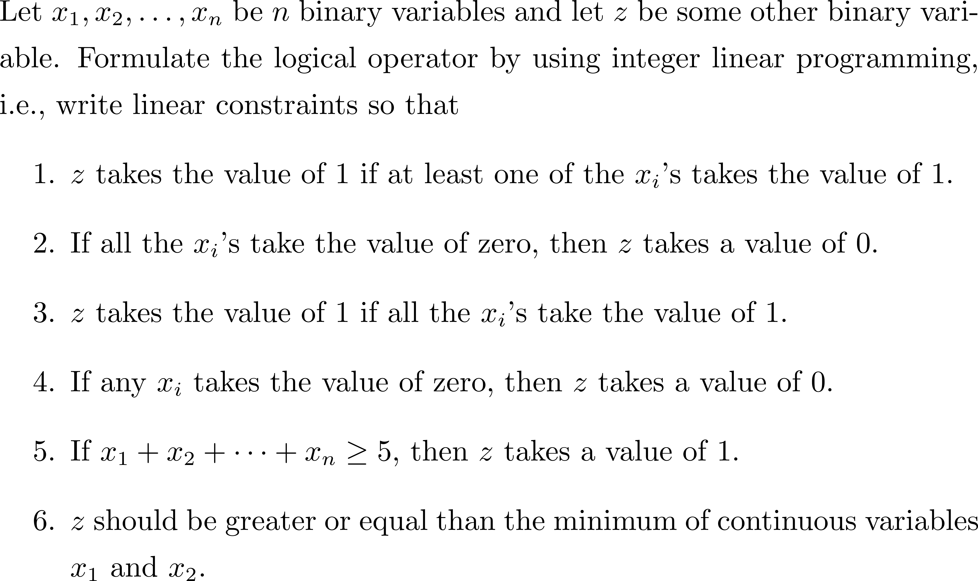
Formulation of Some Conditions

Slide 22
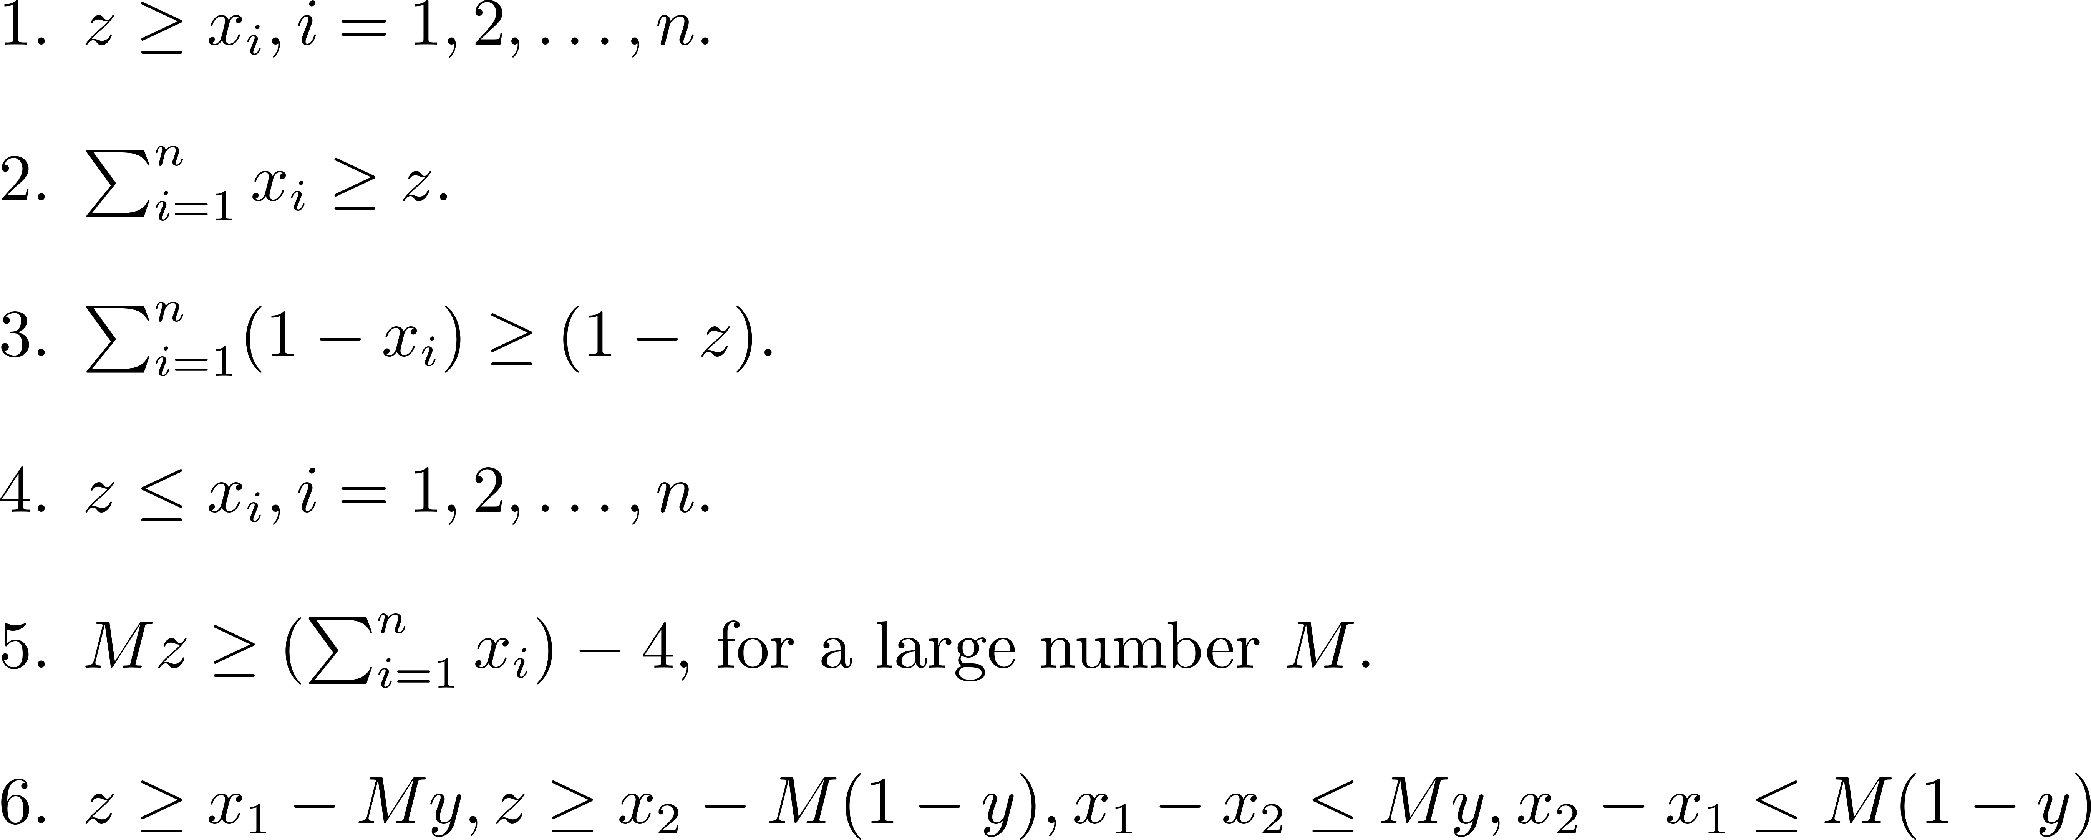
Formulation of Some Conditions

Slide 23
Course Selection
Linda Lee, a second year BCG student, would like to determine her course schedule for her two semesters. Linda has created a list of twenty potential courses that most interest her, shown in table below. Linda has ranked her interest in each of these courses as a number between 3 and 5. The course data is extracted from http://web.nbs.ntu.edu.sg/undergrad/common/contents/courselist.asp

Slide 24
Course Selection
Course Number | Course Code | Course Title | Semester offered | Prerequisites | Interest Level
1 | AB0403 | Decision Making with Programming & Analytics | 1,2 |  | 5
2 | BA2201 | Actuarial Economics | 2 |  | 5
3 | BU5201 | Business Finance | 1,2 |  | 4
4 | BE1401 | Business Operations & Process | 1,2 |  | 4
5 | BT2403 | Service Operations Management | 1 |  | 4
6 | BC3406 | Business Analytics Consulting | 2 | 10, 13 | 3
7 | AB0602 | Communication Management Strategies | 1,2 |  | 3
8 | AB5103 | Audit Analytics | 1,2 | 1 | 5
9 | BF3224 | Equity Investing with Big Data | 2 | 13 | 4
10 | BC2406 | Analytics I: Visual & Predictive Techniques | 1 | 1 | 4
11 | BC2407 | Analytics II: Visual & Predictive Techniques | 2 | 1,10 | 3
12 | BM2507 | Marketing Analytics | 1,2 | 13 | 3
13 | AB1202 | Statistics & Analysis | 1,2 |  | 4
14 | BC2408 | Supply Chain Analytics | 2 | 4 | 4
15 | BC2410 | Prescriptive Analytics: From Data to Decision | 2 | 1 | 5
16 | BU5644 | Smarter Brain? The Science of Decision Making Management | 2 |  | 5
17 | AB0502 | Managing Sustainability | 1 |  | 5
18 | BM2501 | Market Behaviour | 1,2 | 20 | 3
19 | BM2504 | Integrated Marketing Communications | 2 | 20 | 3
20 | AB1501 | Marketing | 1,2 |  | 4

Slide 25
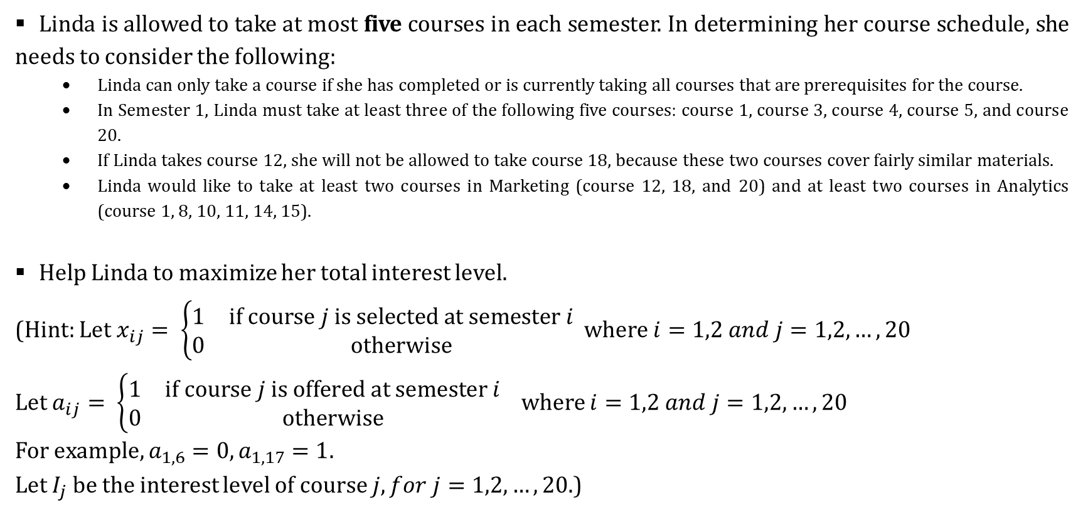
Course Selection
Linda is allowed to take at most five courses in each semester. In determining her course schedule, she needs to consider the following:
Linda can only take a course if she has completed or is currently taking all courses that are prerequisites for the course.
In Semester 1, Linda must take at least three of the following five courses: course 1, course 3, course 4, course 5, and course 20.
If Linda takes course 12, she will not be allowed to take course 18, because these two courses cover fairly similar materials.
Linda would like to take at least two courses in Marketing (course 12, 18, and 20) and at least two courses in Analytics (course 1, 8, 10, 11, 14, 15).
Help Linda to maximize her total interest level.
(Hint: Let $x_{ij}= \left\{\begin{matrix}1 & if course j is selected at semester i \\ 0 & otherwise\end{matrix}\right.$ where $i=1,2 and j=1,2,…,20$
Let $a_{ij}= \left\{\begin{matrix}1 & if course j is offered at semester i \\ 0 & otherwise\end{matrix}\right.$ where $i=1,2 and j=1,2,…,20$
For example, $a_{1,6}=0, a_{1,17}=1$.
Let $I_{j}$ be the interest level of course $j, for j=1,2,…,20$.)

Slide 26
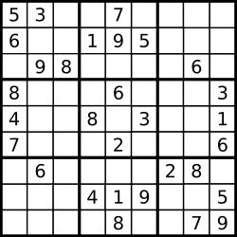
Sudoku (Optional)
Developed by Howard Garns and first published in 1979
Popularized in Japan since 1980’s
Rules: to fill a 9x9 grid with digits so that
Each column contains all the digits from 1 to 9
Each row contains all the digits from 1 to 9
Each 3x3 block contains all the digits from 1 to 9
Many algorithms available
One by PM Lee
Notes:
x1 != x2, not a linear constrain.
X115 = 1
x216 = 1
X31? = 1
x418 = 1
X514 = 1

Slide 27
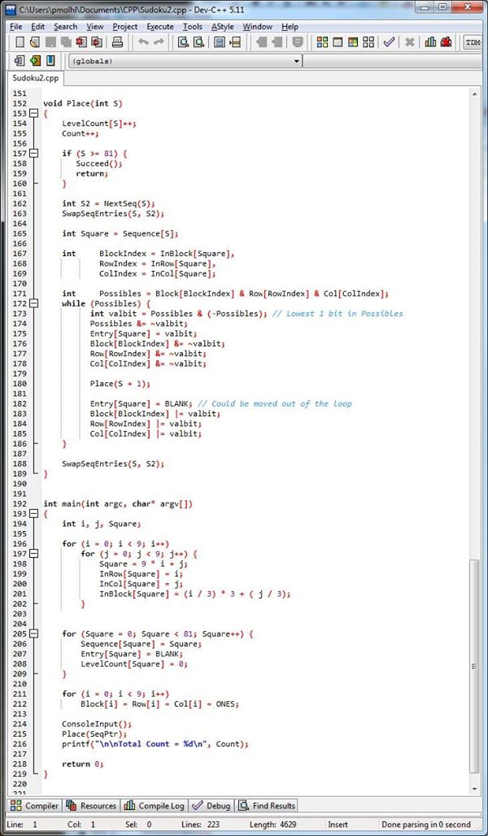
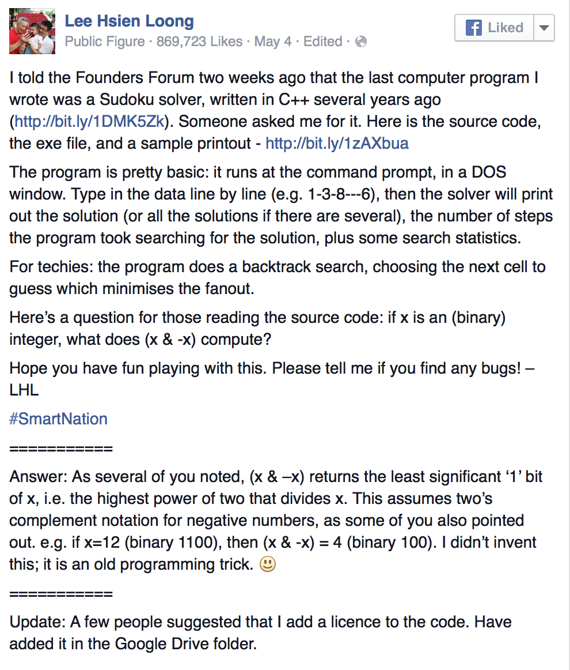
Sudoku (Optional)

Slide 28
Sudoku – IP Formulation (Optional)
Constraints:
Only one k in each column
Only one k in each row
Only one k in each 3x3 block
All cells must be filled
The set of initially given numbers cannot be changed
Binary

Slide 29
Sudoku – IP Formulation (Optional)
Objective ???
Nothing to maximize or minimize
Just looking for a feasible solution => Feasibility Problems
Decision variables: x_{ijk} --- whether cell (i, j) contains digit k (binary)

Slide 30
Sudoku – IP Formulation (Optional)

Slide 31
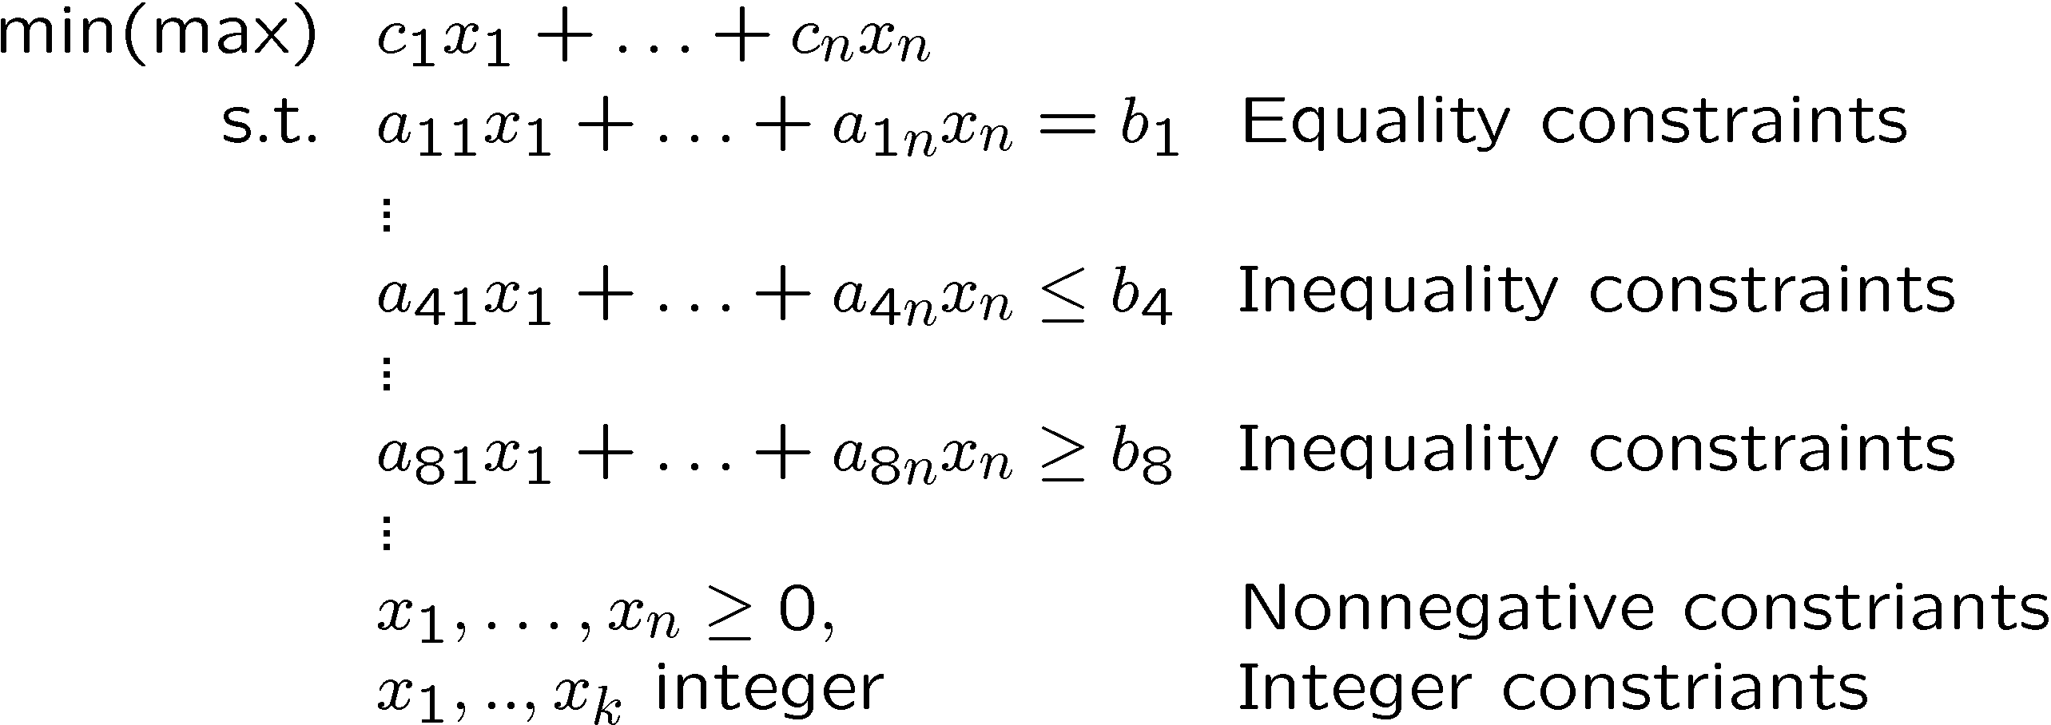
Solution Approach in Discrete Optimization
Mixed Integer Programming
Notes:
Most of the time, it doesn’t have dual problem.

Slide 32

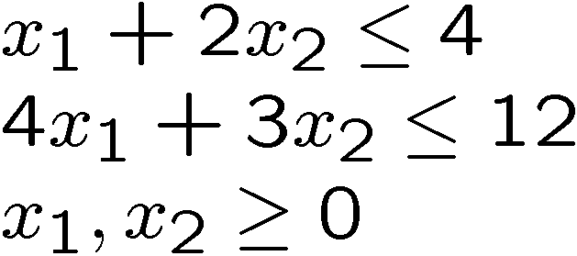

Geometric Interpretation
4
3
2
1
0
0
1
2
3
4
5
6
7
Notes:
Certain problems you can use the relaxation, but some cannot.

Slide 33
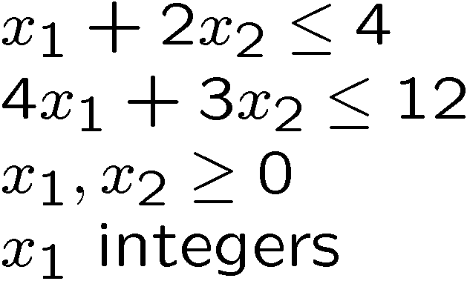
Geometric Interpretation
4
3
2
1
0
0
1
2
3
4
5
6
7

Slide 34
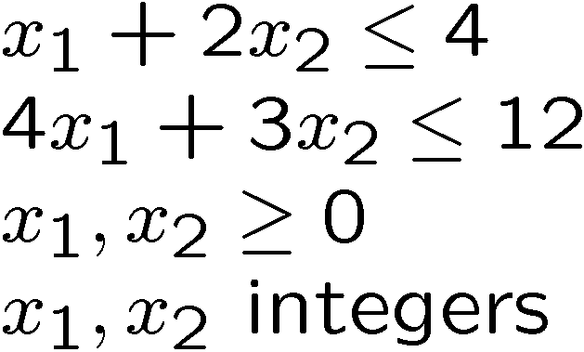
Geometric Interpretation
4
3
2
1
0
0
1
2
3
4
5
6
7

Slide 35
Solution Strategy (Optional)
y
4
3
2
1
0
x
0
1
2
3
Solving the linear relaxation
problem provides a bound. Also...

Slide 36
Branch and Bound (Optional)
infeasible
y
infeasible
4
3
bound
optimal
2
1
0
x
0
1
2
3
Notes:
Each partition increases number of problems by 2 times. Could be exponential.

Slide 37
Computational Issues in Discrete Optimization (Optional)
Bad news: Integer programming are generally hard to solve.
How hard is hard? Generally very hard!!!
Clay Millennium Challenge
http://www.claymath.org/millennium-problems/p-vs-np-problem
Notes:
P: Polynomial time solvable
NP: nondeterministic polynomial time solvable.

Slide 38
Computational Issues in Discrete Optimization (Optional)
Good news:
State of the art solvers such as Gurobi are able to solve many reasonable sized problem of practical importance.
Why do we need to discrete optimization?
Very powerful modeling methods!!
Gurobi report that more than 90% of their clients’ problems are MIP
Sudoku

